Slide 1
Creating Loyal Customers
Increasing Customer Participation
Springboard DSC Capstone 1
Lisa Moller

Slide 2
Project Overview
GOAL
Help nonprofits to retain and grow their donor base using analytics
Target Current Donors
Find New Donors
Budget More Effectively

Slide 3
Target Current Donors
Who
What – the “ask”
When
Where – which events or promotions, for the ask and to keep the donor engaged
How – email, phone, mail

Slide 4
Find New Donors
With a deeper knowledge of current donors, nonprofits can use that information to find new donors
Similar interests
Drives

Slide 5
Budget More Effectively
Manage costs based on predicted lifetime value of the donor.
Analytics can summarize the work of many

Slide 6
Dataset
For-profit clothing store I will call “Threads”
“Data Mining Methods and Models”, by Daniel Larose (2006). http://www.dataminingconsultant.com/DMMM.htm
Fairly clean
Understand customer behavior in general and according to their response, or lack thereof, to a promotion
increase participation in future promotions = increase sales

Slide 7
Dataset
Has 51 features that are tracked by customer ID
zip code
number of purchase visits
total money spent
average amount spent per visit
percent to total sales for each product type
amount spent at four stores
Whether customer is a credit card holder and whether they are an Internet shopper
percent of returns
response rate for other promotions

Slide 8
Digging In…
First looked at data in regards to the promotion – the customers who responded vs. those who did not.
Second, explored overall customer patterns

Slide 9
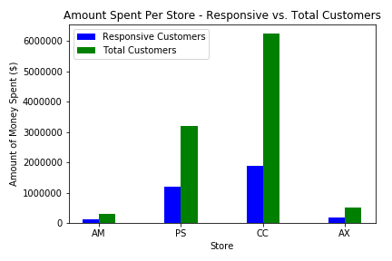
Amount Spent at Four Threads Stores
Notes:
The proportion of sales from the responsive customers to the sales from all customers looks fairly uniform for each store. While more than half of the money spent by responsive customers was at store CC, that amount looks to be proportionate to total sales.

Slide 10
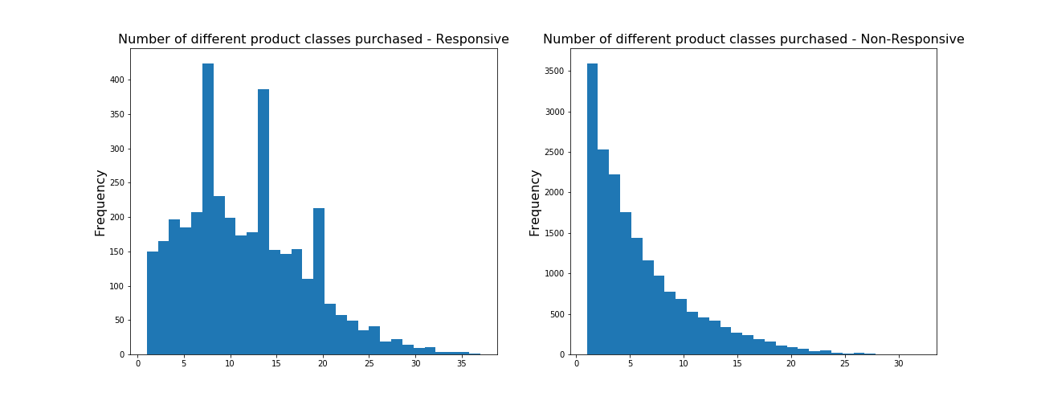
Product Classes Purchased
Notes:
The responsive customers have bought many more classes of products that the non-responsive customers. The histograms show the number of product classes bought by customers along the x-axis, and the frequency along the y-axis.

Slide 11
Statistical Inference
Is there a significant relationship between the number of purchase visits, and the customers’ response to the promotion?
Responsive customers = average of 10.92 purchase visits; Non-responsive customers = average of 3.90 purchase visits
Two-sample t-test
p-value - (8.26 x 10-273) = rejected the null hypothesis (that the Responsive and Non-Responsive customers had the same number of purchase visits)
the difference in the frequency of visits between the Responsive and Non-Responsive groups is statistically significant
Notes:
Generally the z-statistic is used if the sample size is over 30 and you know the population standard deviation. The t-statistic is used if you do not know the population standard deviation and the sample size is less than 30. While our sample size was over 30, we did not know the standard deviation for the population, so used the t-statistic. We used the two-sample t-test because we were looking at a categorical variable with the Responsive and Non-Responsive groups.

Slide 12
What Else?
Overall, responsive customers showed the following characteristics. They…
have more purchase visits
spent more money than non-responsive customers
spent more money when they purchase items
were long-time customers
did not leave as much time between visits as non-responsive customers
bought a larger range of products
were often Internet-shoppers
Notes:
Most of these trends seemed fairly expected for loyal shoppers. Loyal shoppers would be familiar with a brand for a long time; they trust the brand, so they would spend more money on the store. They would also check in fairly consistently as they need new items or to check if there are deals. Being an Internet shopper also makes sense - customers know what they like and what size they wear in the brand. It's easier to buy online when you know what you prefer before you shop.

Slide 13
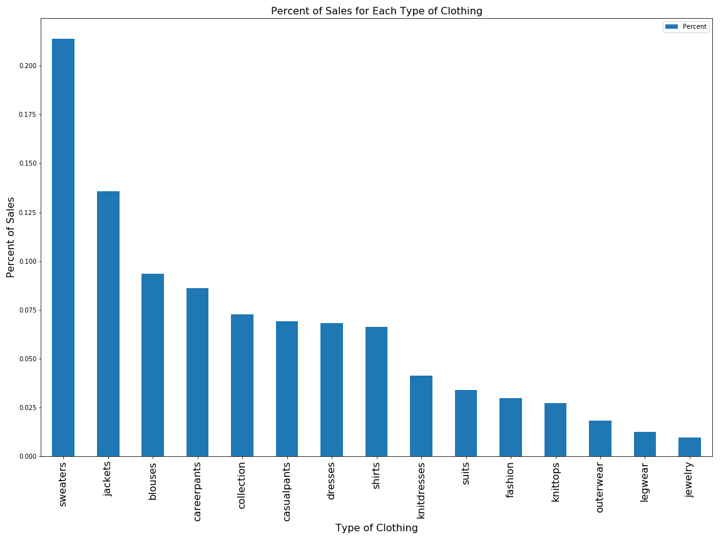
Percent of Sales by Clothing Type
Notes:
Sweaters and outerwear are the largest portion of sales. For another plot, we looked at the percent of sales by zip code. The two zip codes with the highest sales were in Minnesota and Pennsylvania – two areas that can get quite cold. A metric to keep in mind if looking deeper into this data would be the last one/three/six months of sales. The time data may give a better picture also of weather patterns, and if the data is skewed because of the time of year, etc.

Slide 14
Statistical Inference
Correlation
Is there a correlation between the percent of purchases of Jackets and Career Pants?
Hypothesis Test
p-value - (7.877 e-37) = reject the null hypothesis (no correlation between the purchase of Jackets and the purchase of Career Pants)
There was a statistically significant relationship between the percent of purchases a customer has of Jackets and their percent of purchases of Career Pants.
Notes:
What does this tell you? It may be good to have a promo with those two items! Especially to people who have bought only one of the items.

Slide 15
Machine Learning
Logistic Regression
Random Forest
Tuned Hyperparameters on both, but the models still weren’t great
WHY?

Slide 16
Machine Learning
Imbalanced dataset – just under 17% of customers responded to the promotion
Resample
Oversample - SMOTE (Synthetic Minority Oversampling Technique)
Undersample - Random Undersampling technique
Notes:
Oversampling randomly replicates the minority class to increase the population. SMOTE finds the k-nearest neighbors of the minority dataset and uses those to randomly create similar observations. Oversampling can be done before or after the train/test split. The concern with oversampling before the split is "bleeding" the synthetic data into the test set. This would train the model to better predict the test set than a new dataset. For this reason, we performed oversampling after the train/test split, on the training set.
Undersampling randomly samples subsets of the majority class to decrease the population size.

Slide 17
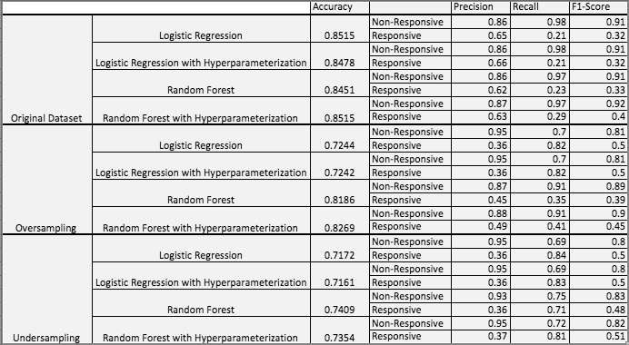
Machine Learning
Notes:
Precision: Precision is the number of true positive results divided by the number of total (true and false) positive results. It measures the quality of the classification.
Recall: Recall is the number of true positive results divided by the true positives and false negatives (items that should've been in the positive class, but were not). This is a measure of completeness.
F1 Score: The F1 score is a weighted average of the precision and recall. An F1 score reaches its best value at 1 and worst score at 0.

Slide 18
Machine Learning
Can be difficult to determine if there is a clear “winner”
To compare the models using one standardized value instead of several metrics, we graphed the Receiver Operating Characteristic (ROC) curves

Slide 19
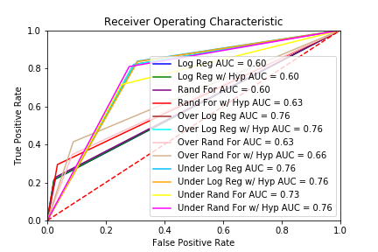
Machine Learning
Notes:
A client's needs have a large impact on which model to choose. While all clients will want to be conscious of how they spend their money, each client will have a different comfort level with the proportions of True Positive and False Positive results. In this case, Threads is a large clothing store that presumably has a larger budget. They may be more comfortable with a larger False Positive rate than a small nonprofit.

Slide 20
Machine Learning
Logistic Regression with Hyperparameterization model from the Oversampled test run
Feature Importance
'LTFREDAY' - Lifetime average time between visits
'FRE' - Number of purchase visits
'FREDAYS' - Number of days between purchases
Notes:
By picking a model with a high True Positive rate, we have a higher likelihood of reaching customers who will respond to the promotion. The tradeoff is that the chosen model also has a higher False Positive rate than some of the other models. This means that we will also be reaching out to customers who are not likely to respond to the promotion.
The most important feature in the chosen Logistic Regression model was the 'Lifetime average time between visits'. The feature was a negative indicator, meaning as the average time between visits increased, the likelihood of the customer responding to the promotion decreased.

Slide 21
Evaluation/Recommendations
Use the chosen Logistic Regression model to target the customers who are most likely to respond
Focus on the behaviors identified in the exploratory analysis as characteristic of responsive customers, and also the most important features within the model and use those to target the “next level” of customers.
Exploratory analysis: the frequency of visits, the range of products bought, and Internet activity.
Model: the lifetime average time between visits, number of purchase visits, number of days between purchases, spending at the CC store, and spending at the PS store.

Slide 22
Next Steps/Improvements
Improving the model!
Train the model on most important (it may help remove some of the “noise”)
Clustering algorithm to provide Threads with another view of customers
A survey of customer motivations and preferences

Slide 23
Questions?

